Slide 1
TCP/IP Model and IP Addressing

Slide 2
TCP/IP Model
This model has 4 layers compared to OSI which has 7 layers.
It combines OSI’s several layers to one layer.
TCP/IP uses the client/server model of communication in which a user or machine by is provided a service by another computer in the network.
Collectively, the TCP/IP suite of protocols is classified as stateless, which means each client request is considered new because it is unrelated to previous requests. Being stateless frees up network paths so they can be used continuously.
The transport layer itself, however, is stateful . It transmits a single message, and its connection remains in place until all the packets in a message have been received and reassembled at the destination.
TCP/IP grew out of U.S. Department of Defence networking research.
TCP/IP is known as "the language of the Internet." If you want a computer to work on the Internet, you have to use TCP/IP.

Slide 3
Features of TCP/IP
1) Multi-Vendor Support. TCP/IP is implemented by many hardware and software vendors. It is an industry standard and not limited to any specific vendor.
2) Interoperability. Today we can work in a heterogeneous network because of TCP/IP. A user who is sitting on a Windows box can download files from a Linux machine, because both Operating Systems support TCP/IP. TCP/IP eliminates the cross-platform boundaries.
3) Logical Addressing. Every network adapter has a globally unique and permanent physical address, which is known as MAC address (or hardware address). The physical address is burnt into the card while manufacturing. Low-lying hardware-conscious protocols on a LAN deliver data packets using the adapter's physical address. The network adapter of each computer listens to every transmission on the local network to determine whether a message is addressed to its own physical address.

Slide 4
Continue…
4) Routability. A router is a network infrastructure device which can read logical addressing information and direct data across the network to its destination.TCP/IP is a routable protocol, which means the TCP/IP data packets can be moved from one network segment to another.
5) Name Resolution. IP addresses are designed for the computers and it is difficult for humans to remember many IP addresses. TCP/IP allows us to use human-friendly names, which are very easy to remember (Ex. www.omnisecu.com). Name Resolutions servers (DNS Servers) are used to resolve a human readable name (also known as Fully Qualified Domain Names (FQDN)) to an IP address and vice versa.
6) Error Control and Flow Control. The TCP/IP protocol has features that ensure the reliable delivery of data from source computer to the destination computer. TCP (Transmission Control Protocol) defines many of these error-checking, flow-control, and acknowledgement functions.
7) Multiplexing/De-multiplexing. Multiplexing means accepting data from different applications and directing that data to different applications listening on different receiving computers. On the receiving side the data need to be directed to the correct application, for that data was meant for. This is called De-multiplexing. We can run many network applications on the same computer. By using logical channels called ports, TCP/IP provides means for delivering packets to the correct application. In TCP/IP, ports are identified by using TCP or UDP port numbers.

Slide 5
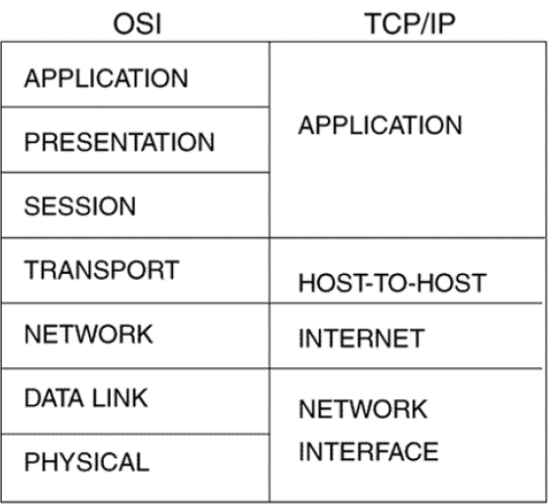

Slide 6
TCP/IP Model Layers
TCP/IP functionality is divided into 4 layers , each of which include specific protocols.
Application Layer : It provides applications with standardized data exchange . Its protocols include Hypertext Transfer Protocol(HTTP), File Transfer Protocol(FTP),Post Office Protocol 3(POP3),Simple Mail Transfer Protocol(SMTP) and Simple Network Management Protocol(SNMP).
Transport Layer : It is responsible for maintaining end-to-end communications across this network . TCP handles communications between hosts and provides flow control , multiplexing and reliability. The transport protocol includes TCP and UDP.
Network Layer :It is also known as internet layer. It deals with packets and connects independent networks to transport the packets across network boundaries . The protocols at this layer are IP and Internet Control Messaging Protocol (ICMP), which is used for error reporting.
Network Interface Layer : It consists of protocols that operate only on a link – the network component that interconnects nodes or hosts in the network . The protocols are Ethernet and Address Resolution Protocol (ARP).

Slide 7
Advantages of TCP/IP
TCP/IP is non-proprietary and therefore not controlled by any single company.
IP Suite can be modified easily.
It is compatible with all Operating systems.
IP Suite is also compatible with all types of computer hardware and networks.
It can determine the most efficient path through the network.

Slide 8
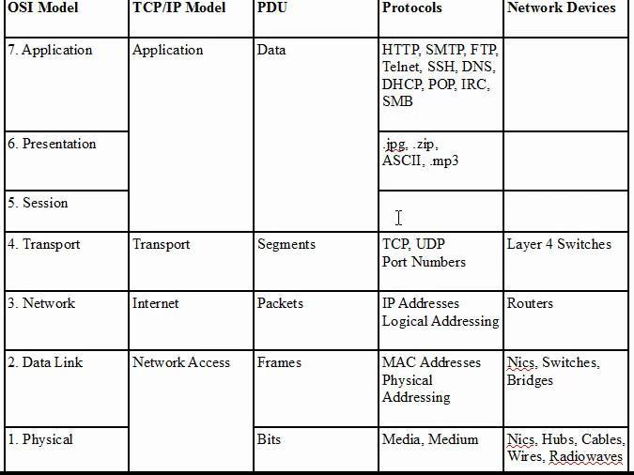
Protocols at Every Layer

Slide 9
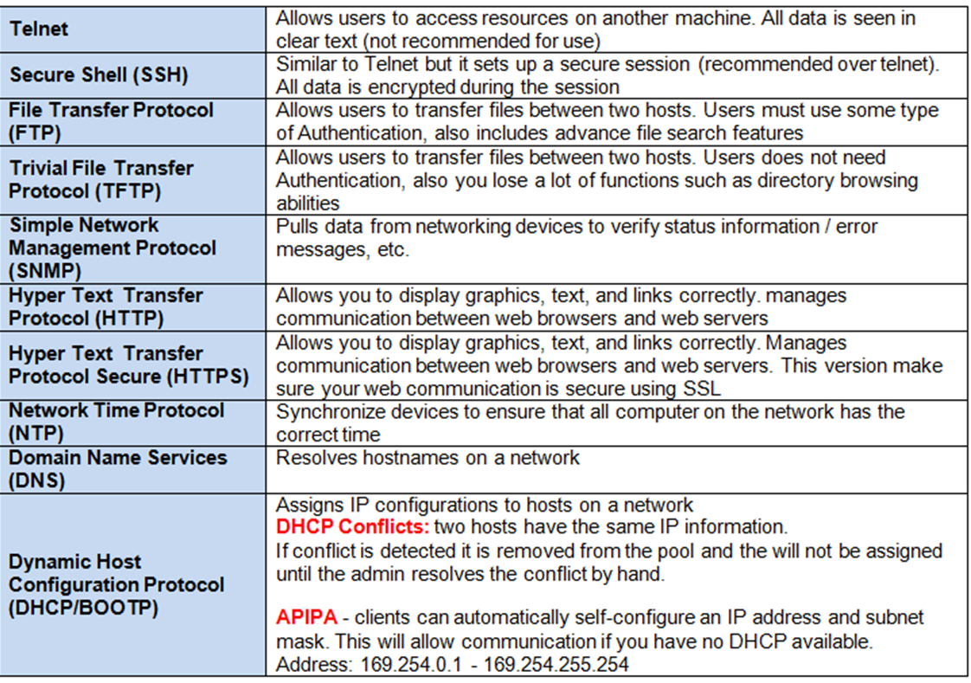

Slide 10
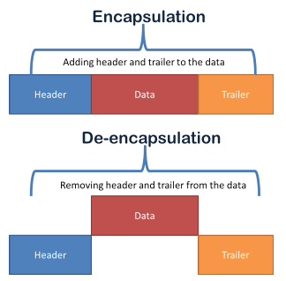

Slide 11
Internetworking Protocol
The Internetworking Protocol (IP) is the transmission mechanism used by the TCP/IP protocols.
IP provides no error checking or tracking therefore it is unreliable.
IP transports data in packets called datagrams, each of which is transported separately.
Datagrams can travel along different routes and can arrive out of sequence or be duplicated.
IP does not keep track of the routes and has no facility for reordering datagrams once they arrive at their destination.

Slide 12
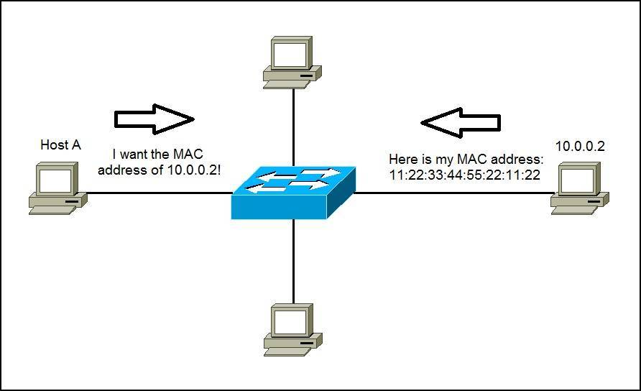
Address Resolution Protocol
ARP is used to associate a logical address with a physical address.
On a physical network, such as LAN , each device on a link is identified by a physical or station address , usually imprinted on NIC.
ARP is used to find the physical address of the node when its Internet address is known.

Slide 13
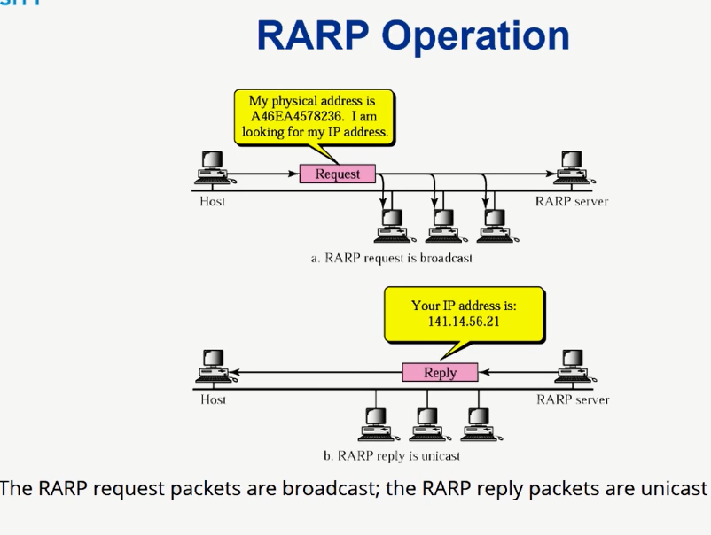
Reverse Address Resolution Protocol
The Reverse Address Resolution Protocol (RARP) allows a host to discover its Internet address when it knows only its physical address.
It is used when a computer is connected
to a network for the first time or when a diskless computer is booted.

Slide 14
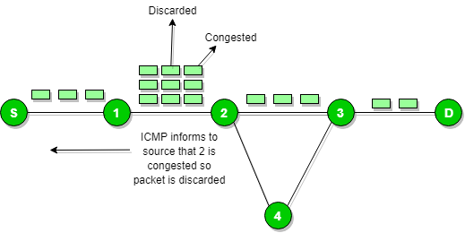
Internet Control Message Protocol
The Internet Control Message Protocol (ICMP) is a mechanism used by hosts and gateways to send notification of datagram problems back to the sender.
ICMP sends query and error reporting messages.

Slide 15

ARP ,RARP and ICMP Explained

Slide 16
IP Addressing
Address - The unique number ID assigned to one host or interface in a network.
Subnet - A portion of a network that shares a particular subnet address.
Subnet mask - A 32-bit combination used to describe which portion of an address refers to the subnet and which part refers to the host.
Interface - A network connection.
An IP address is an address used in order to uniquely identify a device on an IP network. The address is made up of 32 binary bits, which can be divisible into a network portion and host portion with the help of a subnet mask.
The 32 binary bits are broken into four octets (1 octet = 8 bits). Each octet is converted to decimal and separated by a period (dot)
For this reason, an IP address is said to be expressed in dotted decimal format (for example, 172.16.81.100). The value in each octet ranges from 0 to 255 decimal, or 00000000 - 11111111 binary..

Slide 17
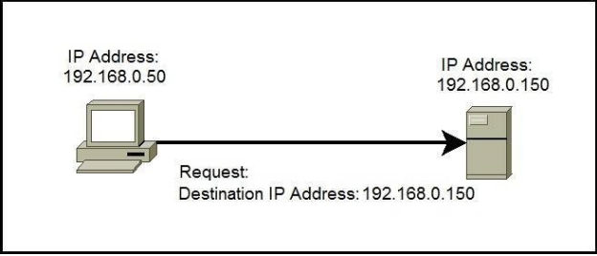
Types of IP addresses
Unicast IP Addresses – an address of a single interface. The IP addresses of this type are used for one-to-one communication. Unicast IP addresses are used to direct packets to a specific host.

Slide 18
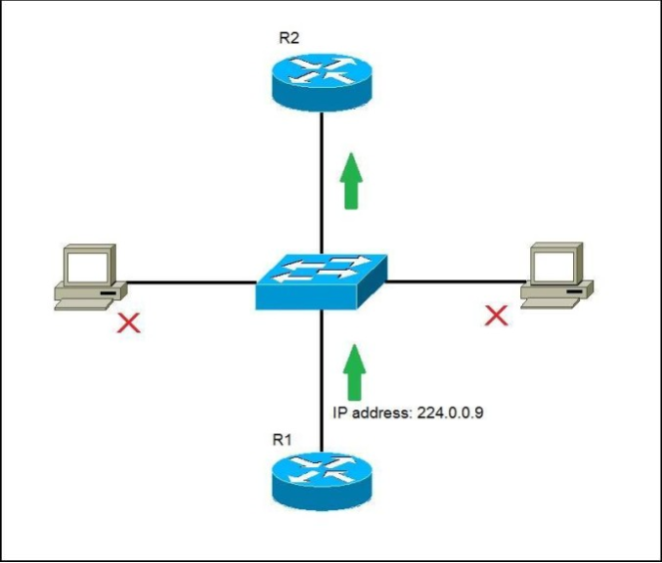
Continue…
Multicast IP Addresses – used for one-to-many communication. Multicast messages are sent to IP multicast group addresses. Routers forward copies of the packet out to every interface that has hosts subscribed to that group address. Only the hosts that need to receive the message will process the packets. All other hosts on the LAN will discard them.

Slide 19
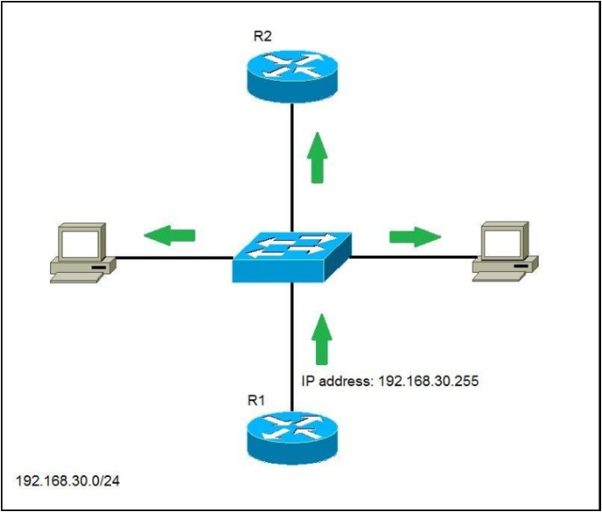
Continue…
Broadcast IP Addresses – used to send data to all possible destinations in the broadcast domain (the one-to-everybody communication). The broadcast address for a network has all host bits on. For example, for the network 192.168.30.0 255.255.255.0 the broadcast address would be 192.168.0.255. Also, the IP address of all 1’s (255.255.255.255) can be used for local broadcast.

Slide 20
IPv4 and IPv6 Addresses
IPv4 addresses are 32 bits long (four bytes). An example of an IPv4 address is 216.58.216.164.
The maximum value of a 32-bit number is 2³², or 4,294,967,296. So the maximum number of IPv4 addresses, which is called its address space, is about 4.3 billion. In the 1980s, this was sufficient to address every networked device, but scientists knew that this space would quickly become exhausted.
A major advantage of IPv6 is that it uses 128 bits of data to store an address, permitting 2¹²⁸ unique addresses, or 340,282,366,920,938,463,463,374,607,431,768,211,456. The size of IPv6's address space — 340 duodecillion — is much, much larger than IPv4.

Slide 21
Classes of IP Addresses
There are five classes of IP Addresses:
Class A
Class B
Class C
Class D
Class E
The system of IP address classes was developed for the purpose of Internet IP addresses assignment. The classes created were based on the network size. For example, for the small number of networks with a very large number of hosts, the Class A was created. The Class C was created for numerous networks with small number of hosts.
For the IP addresses from Class A, the first 8 bits (the first decimal number) represent the network part, while the remaining 24 bits represent the host part. For Class B, the first 16 bits (the first two numbers) represent the network part, while the remaining 16 bits represent the host part. For Class C, the first 24 bits represent the network part, while the remaining 8 bits represent the host part.

Slide 22
Special IP Address Range
Special IP address ranges that are used for special purposes are:
0.0.0.0/8 – addresses used to communicate with the local network
127.0.0.0/8 – loopback addresses
169.254.0.0/16 – link-local addresses (APIPA)

Slide 23
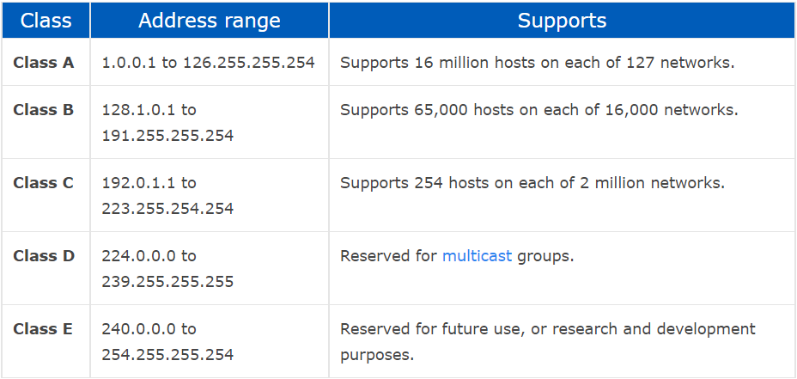
Classes with their Range

Slide 24
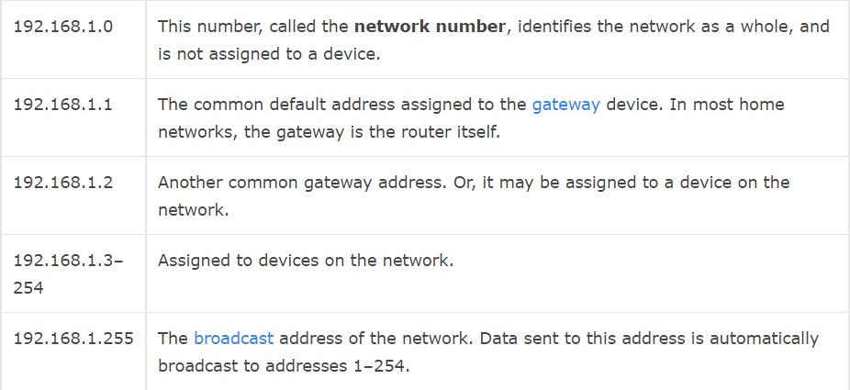
Static vs. Dynamic IP Addresses
IP addresses are assigned in two different ways. They may be dynamically assigned (they can change automatically) or statically assigned (they're intended not to change, and must be changed manually). Most home networks use dynamic allocation. Your router uses DHCP to temporarily assign, or "lease," an IP address to your device. After a period of time, this lease "expires," and the router renews your old address or assigns you a new one, depending on the needs of the network and the configuration of the router.

Slide 25
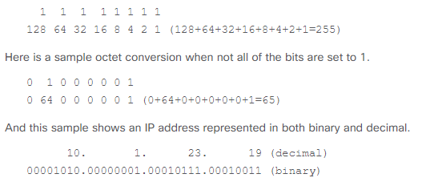
Binary to Decimal Conversion
The right most bit, or least significant bit, of an octet holds a value of 2⁰.
The bit just to the left of that holds a value of 2¹.
This continues until the left-most bit, or most significant bit, which holds a value of 2⁷.
if all binary bits are a one, the decimal equivalent would be 255 as shown here:

Slide 26
IP Address Notations
There are two types of notations for an IP Address:
Binary Notation : The IPv4 address is displayed as 32 bits. Each octet is often referred to as a byte. The following is an example of an IPv4 address in binary notation:
01110101 10010101 00011101 00000010
Dotted-Decimal Notation : To make the IPv4 address more compact and easier to read, Internet addresses are usually written in decimal form with a decimal point (dot) separating the bytes. The following is the dotted-decimal notation of the above address:
117.149.29.2

Slide 27
Questions
Change the following IPv4 addresses from binary notation to dotted-decimal notation.
a. 10000001 00001011 00001011 11101111
b. 11000001 10000011 00011011 11111111
Change the following IPv4 addresses from dotted-decimal notation to binary notation.
a. 111.56.45.78
b. 221.34.7.82
Find the error, if any, in the following IPv4 addresses.
a. 111.56.045.78
b. 221.34.7.8.20
c. 75.45.301.14
d. 11100010.23.14.67

Slide 28
Questions
Binary of 121
Decimal of 10010111
If you are the network administrator of an Organization and you have 10 departments. Which class you will use to assign IP addresses?

Slide 29
Network Masks
A network mask helps you know which portion of the address identifies the network and which portion of the address identifies the node. Class A, B, and C networks have default masks, also known as natural masks, as shown here:
Class A: 255.0.0.0
Class B: 255.255.0.0
Class C: 255.255.255.0
How the mask determines the Network ID and Host ID
8.20.15.1 = 00001000.00010100.00001111.00000001
255.0.0.0 = 11111111.00000000.00000000.00000000
Address bits which have corresponding mask bits set to 1 represent the network ID. Any address bits that have corresponding mask bits set to 0 represent the node ID.

Slide 30
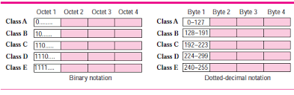
Classful Addressing
IPv4 addressing, at its inception, used the concept of classes. This architecture is called classful addressing.
In classful addressing, the address space is divided into five classes: A, B, C, D and E. Each class occupies some part of the address space.
We can find the class of an address when given the address in binary notation or dotted-decimal notation. If the address is given in binary notation, the first few bits can immediately tell us the class of the address. If the address is given in decimal-dotted notation, the first byte defines the class.

Slide 31
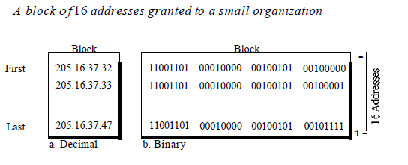
Classless Addressing
To overcome address depletion and give more organizations access to the Internet, classless addressing was designed and implemented. In this scheme, there are no classes, but the addresses are still granted in blocks.
Restriction : To simplify the handling of addresses, the Internet authorities impose three restrictions on classless address blocks:
1. The addresses in a block must be contiguous, one after another.
2. The number of addresses in a block must be a power of 2 (I, 2, 4, 8, ... ).
3. The first address must be evenly divisible by the number of addresses.

Slide 32
CIDR
Classless Interdomain Routing (CIDR) was introduced in order to improve both address space utilization and routing scalability in the Internet.
It was needed because of the rapid growth of the Internet and growth of the IP routing tables held in the Internet routers.
In CIDR , an IP network is represented by a prefix, which is an IP address and some indication of the length of the mask.
Length means the number of left-most contiguous mask bits that are set to one. So network 172.16.0.0 255.255.0.0 can be represented as 172.16.0.0/16.

Slide 33
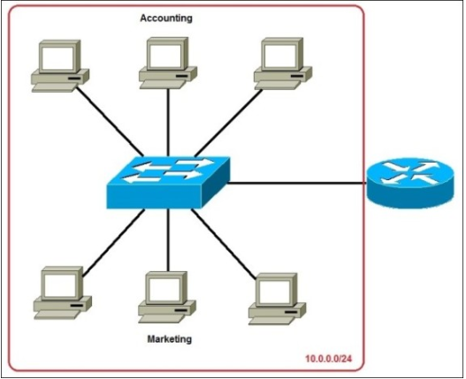
Subnetting
Subnetting is the practice of dividing a network into two or more smaller networks. It increases routing efficiency, enhances the security of the network and reduces the size of the broadcast domain.

Slide 34
Understand Subnetting
Subnetting allows you to create multiple logical networks that exist within a single Class A, B, or C network. If you do not subnet, you are only able to use one network from your Class A, B, or C network, which is unrealistic.
In order to subnet a network, extend the natural mask with some of the bits from the host ID portion of the address in order to create a subnetwork ID. For example, given a Class C network of 204.17.5.0 which has a natural mask of 255.255.255.0, you can create subnets in this manner:
204.17.5.0 - 11001100.00010001.00000101.00000000
255.255.255.224 - 11111111.11111111.11111111.11100000
There are two ways to denote these masks. First, since you use three bits more than the "natural" Class C mask, you can denote these addresses as having a 3-bit subnet mask. Or, secondly, the mask of 255.255.255.224 can also be denoted as /27 as there are 27 bits that are set in the mask.
This second method is used with CIDR. With this method, one of these networks can be described with the notation prefix/length. For example, 204.17.5.32/27 denotes the network 204.17.5.32 255.255.255.224.

Slide 35
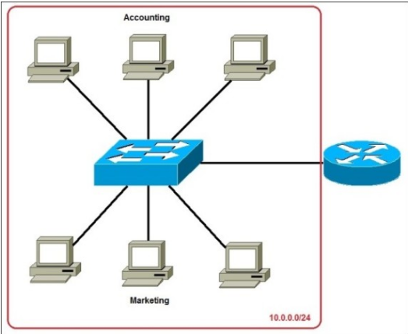
Why do we need subnetting?
Consider the below example:
Disadvantages :
A single broadcast domain
Network Security
Organizational Problems
Network: 10.0.0.0/24
All hosts are in the same subnet.

Slide 36
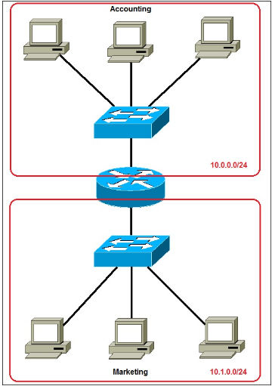
Solution for the problem

Slide 37
Creating Subnets
To create subnets ,we should ask following question to ourselves:
1. How many subnets do we need?
2x = number of subnets. x is the number of 1s in the subnet mask. With 1 subnet bit, we can have 21 or 2 subnets. With 2 bits, 22 or 4 subnets, with 3 bits, 23 or 8 subnets, etc.
2. How many hosts per subnet do we need?
2y – 2 = number of hosts per subnet. y is the number of 0s in the subnet mask.

Slide 38
Subnetting Example
Consider an example that we need to subnet a class C address 192.168.0.0/24.
We need two subnets with 50 hosts per subnet.
1. Since we need only two subnets, we need 2¹ subnet bits.
We have a class C address 192.168.0.0 with the subnet mask of 24. Let’s convert them to binary:
192.168.0.0 = 11000000.10101000.00000000.00000000
255.255.255.0 = 11111111.11111111.11111111.00000000
We have to borrow one bit from the host part. So our new subnet will be :
255.255.255.128 = 11111111.11111111.11111111.10000000
The ones in the subnet mask represent the network.

Slide 39
Continue…
We need 50 hosts per subnet. Since, we have taken 1 bit from the host part , we are left with 7 bits. But is it enough for 50 hosts?
To calculate the number of hosts, the formula we have is 2^{y} – 2. Y is the no. of host bits. Since, 2⁷ – 2 is 126 we have enough no. of hosts.
Our Subnet will look like this:
192.168.0.0/25 – the first subnet has the subnet number of 192.168.0.0. The range of IP addresses in this subnet is 192.168.0.0 – 192.168.0.127.
192.168.0.128/25 – the second subnet has the subnet number of 192.168.0.128. The range of IP addresses in this subnet is 192.168.0.128 – 192.168.0.255.

Slide 40
Class C Subnetting
Subnet the Class C IP Address 195.1.1.0 so that you have 10 subnets each with a maximum of 12 hosts on each subnet.
Current Mask = 255.255.255.0
Bits need for 10 subnets=4 = 2⁴ = 16 possible subnets.
Bits need for 12 hosts = 4 = 2⁴ = 16-2 = 14 possible hosts.
Final Subnet Mask=255.255.255.240

Slide 41
Question
Subnet the Class C IP Address 205.11.2.0 so that you have 30 subnets.
What is the subnet mask for the maximum number of hosts?
How many hosts each subnet can have.
What is the IP Address of host 3 on subnet 2.

Slide 42
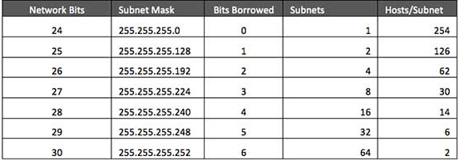
Class C subnets

Slide 43
Class B Subnetting
Consider that you have been allocated a Class B network address of 135.1.0.0 and we need to create 4 subnets each with around 200 hosts. What will be the subnet mask to fulfill this condition.
Subnet Mask for Class B= 255.255.0.0
Need of Subnets = 4 = 2²
New subnet Mask = 255.255.192.0

Slide 44
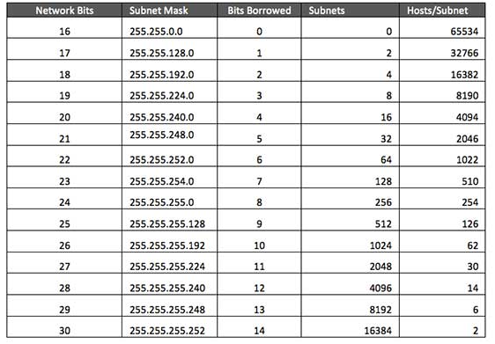
Class B Subnets

Slide 45
Questions
Subnet the Class B IP Address 191.11.2.0 so that you have 14 subnets.
What is the subnet mask for the maximum number of hosts?
How many hosts each subnet can have.
What is the Broadcast Address of subnet 1.

Slide 46
Class A Subnetting
You have been allocated a Class A network address of 29.0.0.0. We need to create at least 20 networks and each network will support a maximum of 160 hosts.
Will the following 2 subnet masks work?
255.255.0.0 and or 255.255.255.0
Mask 255.255.0.0 has 8 bits for the subnet and 16 bits for the host.
8 bits would accommodate 256 subnets.
16 bits would accommodate over 64,000 hosts
Mask 255.255.255.0 has 16 bits for the subnet and 8 bits for the host.
Possible hosts 254 that are enough.

Slide 47
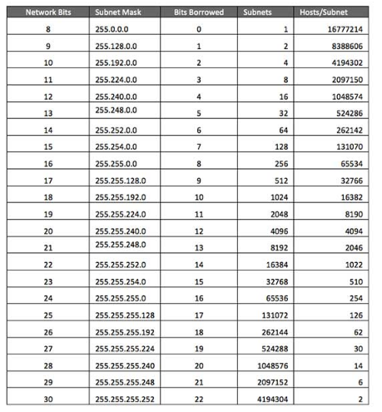
Class A Subnets

Slide 48
VLSM
Having the same subnet mask for all subnets ends up wasting address space.
Internet Service Providers may face a situation where they need to allocate IP subnets of different sizes as per the requirement of customer. One customer may ask Class C subnet of 3 IP addresses and another may ask for 10 IPs.
For example, an administrator have 192.168.1.0/24 network. The suffix /24 tells the number of bits used for network address. In this example, the administrator has three different departments with different number of hosts. Sales department has 100 computers, Purchase department has 50 computers, Accounts has 25 computers and Management has 5 computers. In CIDR, the subnets are of fixed size. Using the same methodology the administrator cannot fulfill all the requirements of the network.

Slide 49
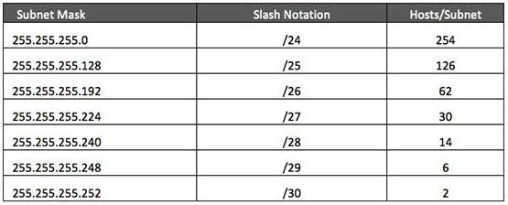
VLSM Continue…
Step – 1 : Make a list of subnets possible.
Step – 2 : Sort the requirements of IPs in descending order (Highest to Lowest).
Sales 100
Purchase 50
Accounts 25
Management 5

Slide 50
VLSM Continue…
Step-3 : Allocate the highest range of IPs to the highest requirement, so let's assign 192.168.1.0 /25 (255.255.255.128) to the Sales department. This IP subnet with Network number 192.168.1.0 has 126 valid Host IP addresses which satisfy the requirement of the Sales department. The subnet mask used for this subnet has 10000000 as the last octet.
Step-4 : Allocate the next highest range, so let's assign 192.168.1.128 /26 (255.255.255.192) to the Purchase department. This IP subnet with Network number 192.168.1.128 has 62 valid Host IP Addresses which can be easily assigned to all the PCs of the Purchase department. The subnet mask used has 11000000 in the last octet.
Step-5 : Allocate the next highest range, i.e. Accounts. The requirement of 25 IPs can be fulfilled with 192.168.1.192 /27 (255.255.255.224) IP subnet, which contains 30 valid host IPs. The network number of Accounts department will be 192.168.1.192. The last octet of subnet mask is 11100000.

Slide 51
VLSM Continue…
Step-5 : Allocate the next highest range to Management. The Management department contains only 5 computers. The subnet 192.168.1.224 /29 with the Mask 255.255.255.248 has exactly 6 valid host IP addresses. So this can be assigned to Management. The last octet of the subnet mask will contain 11111000.
By using VLSM, the administrator can subnet the IP subnet in such a way that least number of IP addresses are wasted. Even after assigning IPs to every department, the administrator, in this example, is still left with plenty of IP addresses which was not possible if he has used CIDR.

Slide 52
Supernetting
Supernetting is the opposite of Subnetting. In subnetting, a single big network is divided into multiple smaller subnetworks. In Supernetting, multiple networks are combined into a bigger network termed as a Supernetwork or Supernet.
Supernetting is mainly used in Route Summarization, where routes to multiple networks with similar network prefixes are combined into a single routing entry, with the routing entry pointing to a Super network, encompassing all the networks. This in turn significantly reduces the size of routing tables and also the size of routing updates exchanged by routing protocols.

Slide 53
Advantages and Disadvantages of Supernetting
Advantages:
Control and reduce network traffic
Helpful to solve the problem of lacking IP addresses
Minimizes the routing table
Disadvantages:
It cannot cover different area of network when combined
All the networks should be in same class and all IP should be contiguous

Slide 54
Keypoints for Supernetting
Supernetting can be done only in same address space. If address space is completely different between two or more routes, they cannot be summarized in a single route. For example, we can’t summarize the route 192.168.1.0/25 with the route 193.168.1.128/25.
A route can be summarized only in a route which is bigger than it in block size. For example we can’t summarize a route of block size 64 in a route of block size 32 but we can summarize two routes of block size 32 in a single route of block size 64.
The easiest way of calculating the summarized route is adding the block size of all sequential routes and using the Subnetting which provides the block size that is equal to the result of addition. For example if we have two sequential routes of block size 16, we can summarize them in a single route of block size 32.
Summarization can be done only in available bock sizes. For example if we have 5 routes of block size 8, we cannot summarize them in single route of block size 40 (8x5). 40 is not a valid block size. In this case, the best choice is summarizing first four routes is single summarized route of block size 32 and keeping the fifth route as it is.

Slide 55
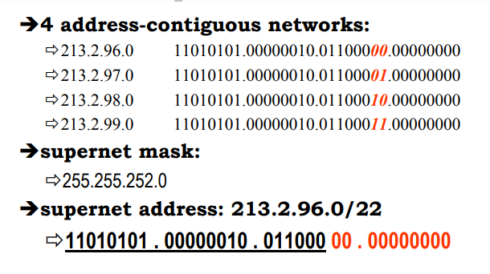
Supernetting Example

